Slide 1
NoSQL - Background

Slide 2
NoSQL Background Topics
System Architecture
  Master-Worker
  Fully distributed/Peer-to-peer
Data Distribution
  Hashing
  Sharding
Data Replication
  Hashing
  Mirroring
Time & Consistency Management

Slide 3
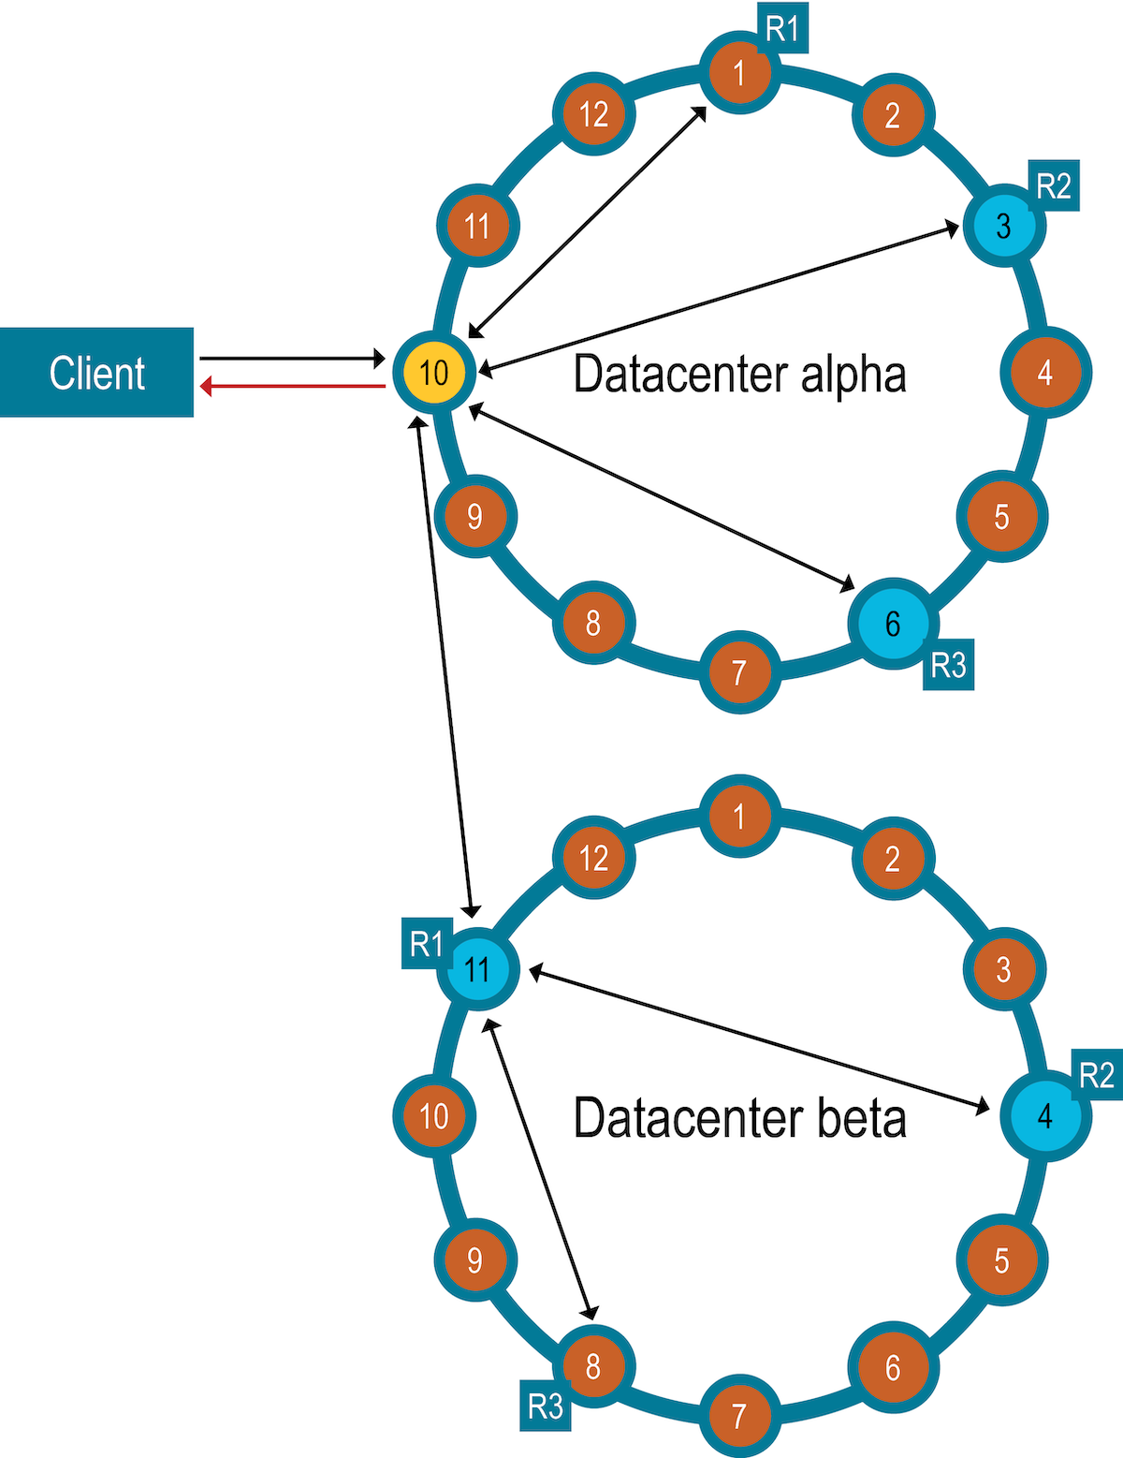
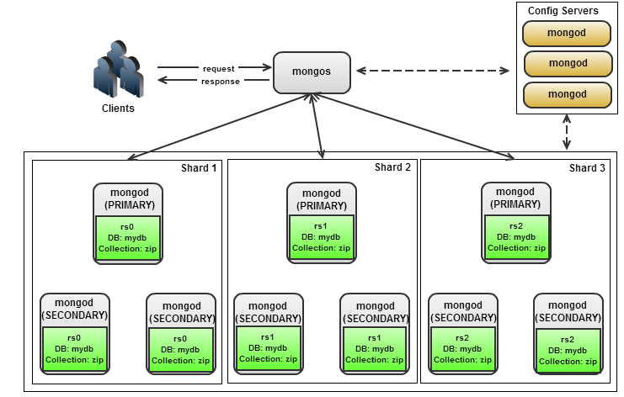
System Architecture
Client
Master-Worker vs. Fully Distributed
How does the architecture affect
  Access
  Fault-tolerance
  Consistency Management
  Replication
  Performance
  Etc.

Slide 4
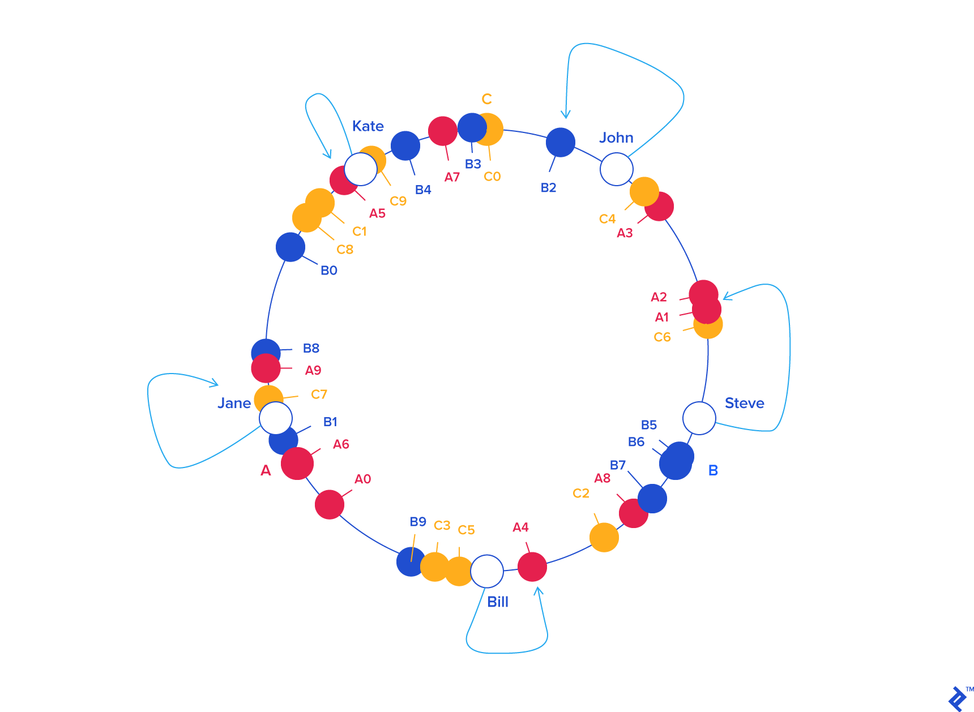
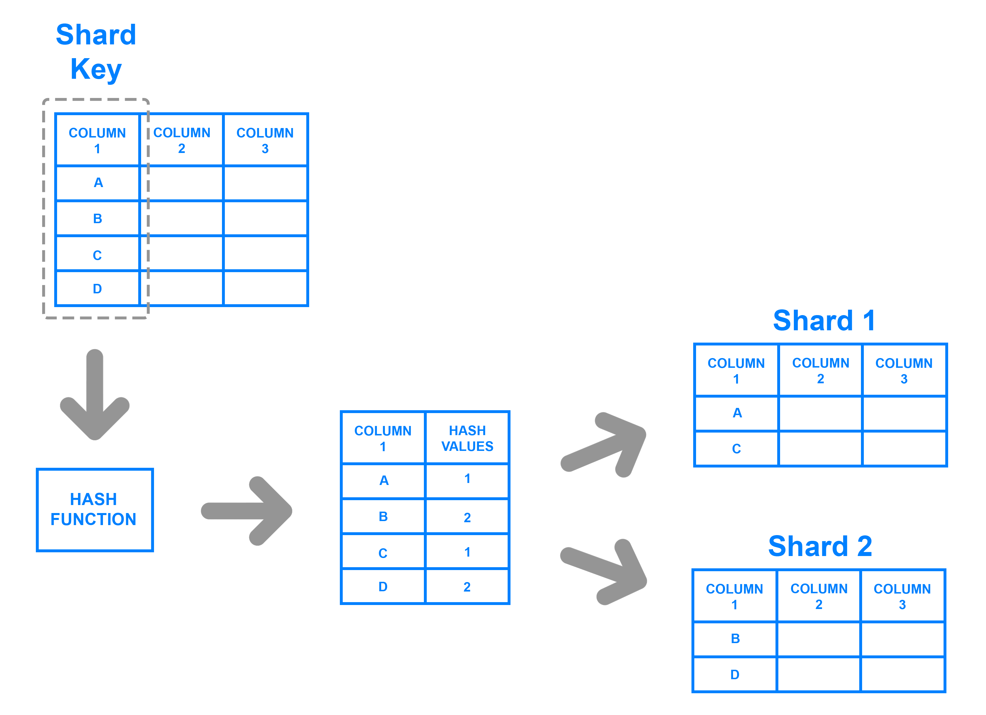
Data Distribution
Sharding vs Hashing
  Vertical (rows) and Horizontal (columns) sharding
  Hash to a location

Slide 5
Data Replication
Use a hash to map data to a node
  Use the same hash for replicates, but advance around the ring
  Use a different hash
Mirroring
  Duplicate data on another node
  Is the mirror part of the cluster or just a dedicated mirror
Random replication
  HDFS
  System must know how to map the data

Slide 6
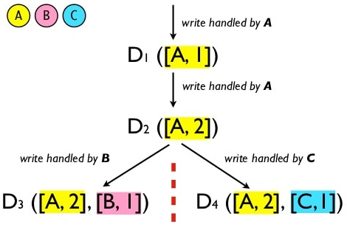
Time and Consistency Management
Timestamps for writes, reads, transactions
Real timestamps
  Clock skew
Logical timestamps
  Ordering?
  Causality
Data Consistency
  Managed by the system
  Managed by the application

Slide 7
We will consider these topics for all the systems we look at the rest of the semester
Two of the topics need more explanation
  Hashing – Consistent Hashing
  Distributed Time

Slide 8
Consistent Hashing

Slide 9
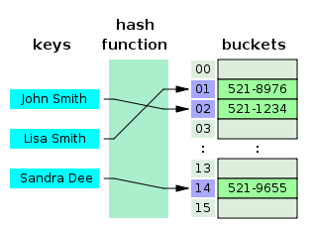
Hash Table
a hash table (hash map) is a data structure that implements an associative array abstract data type, a structure that can map keys to values. A hash table uses a hash function to compute an index, also called a hash code, into an array of buckets or slots, from which the desired value can be found. During lookup, the key is hashed and the resulting hash indicates where the corresponding value is stored.

Slide 10
Hash Function
Distribute key-value pairs across an array of buckets
Index = f(key, array_size) or,
Hash = hashfunc(key)
Index = hash % array_size
Needs to have a uniform distribution
  Particularly for your data
  Avoid hotspots

Slide 11
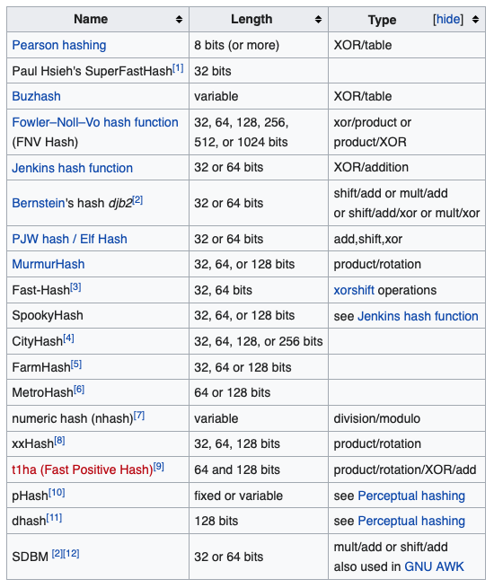
Hash Functions
MD5
SHA-1
CRC-32
Salsa
Spooky
Many others

Slide 12
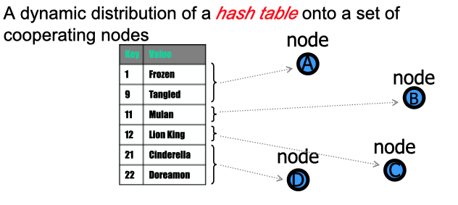
Distributed Hashing

Slide 13
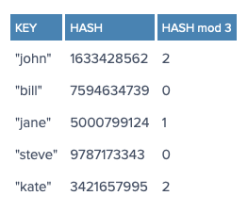
Distributed Hashing
Simplest way is to use mod or div operator
What happens when a node dies?

Slide 14
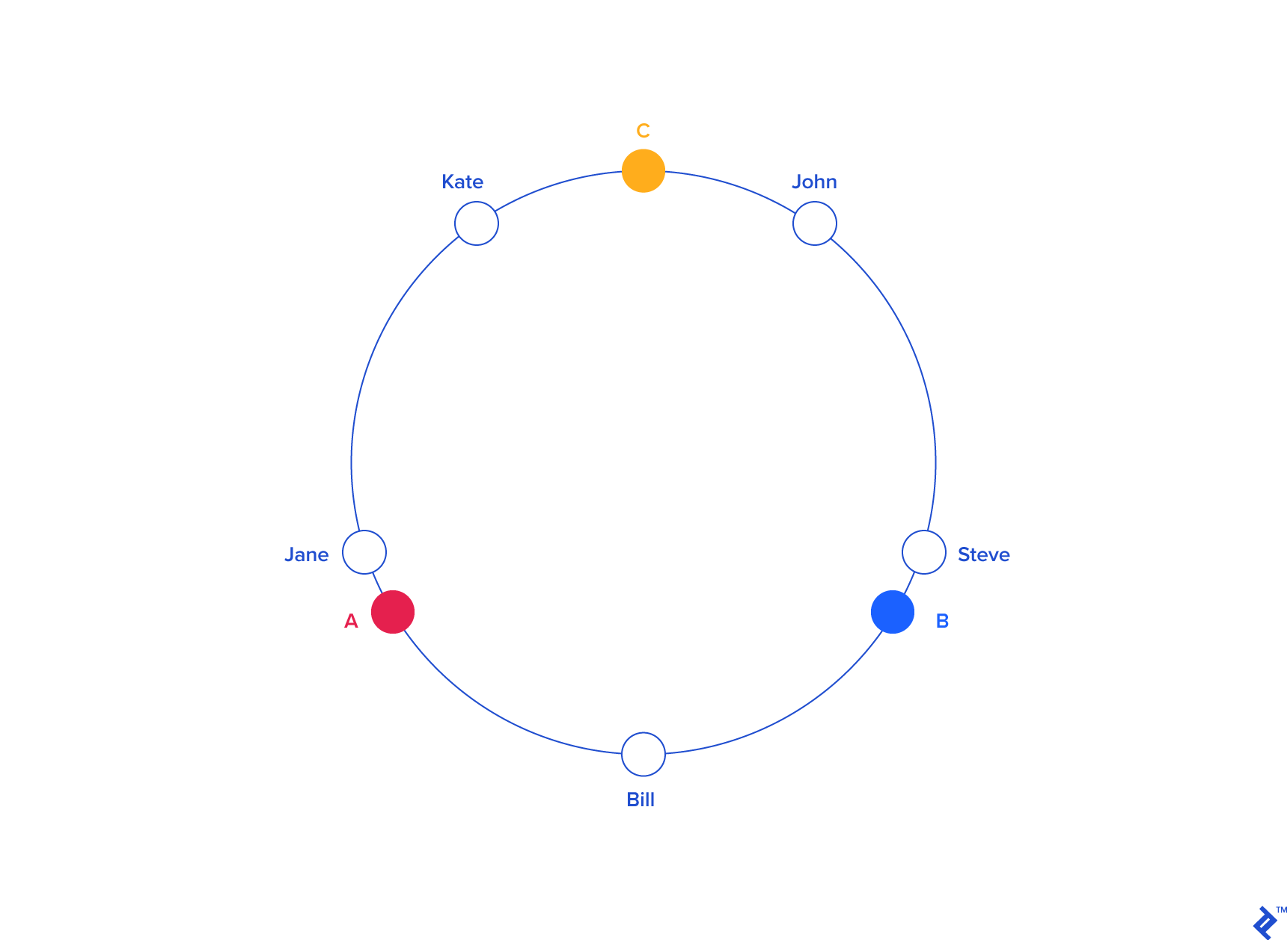
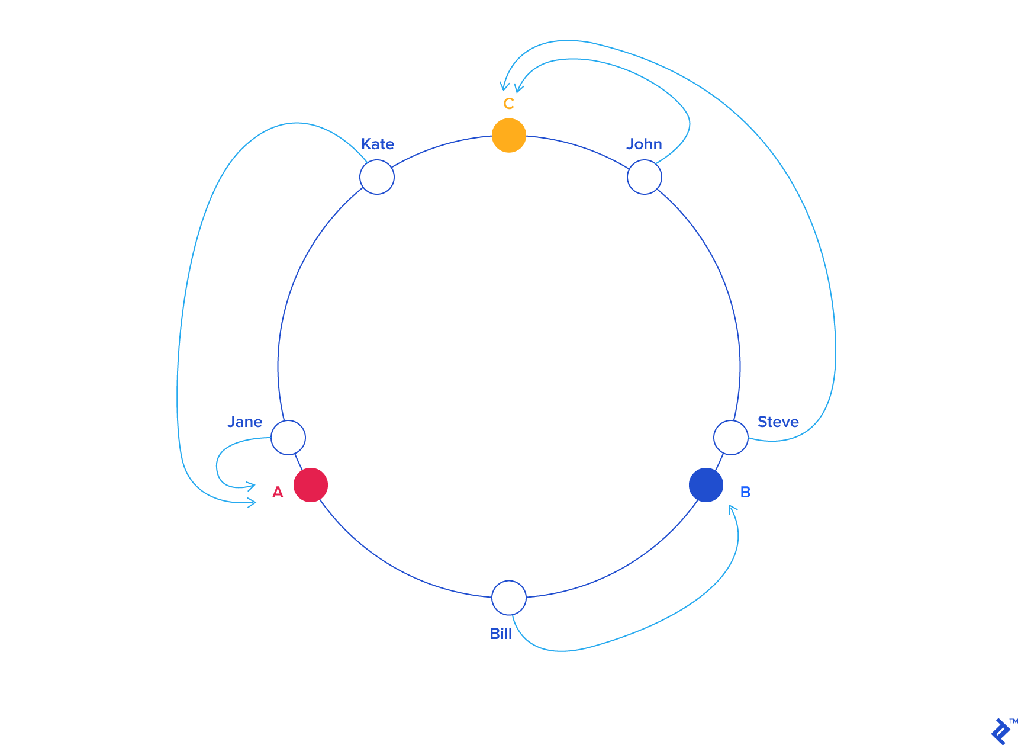
Consistent Hashing
Don’t want to depend on the number of servers
  Key location and server mapped virtually

Slide 15
Consistent Hashing
Can lead to hotspots and load imbalance
Solution
  Virtual Nodes
Replication
  Use another hash function
  Replicate around the ring to next real nodes

Slide 16
Consistent Hashing – Node failure
Node C fails
Remap where the data goes
When a request for data arrives
If not present, look to replicate

Slide 17
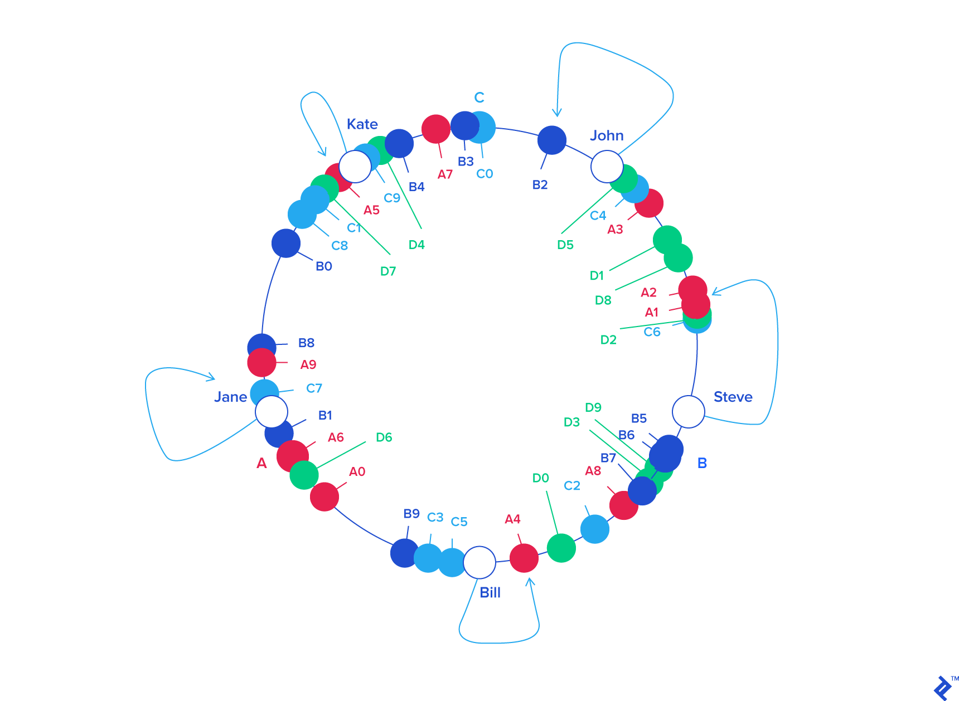
Consistent Hashing – Node Addition
Add Node D
Just hash it into the ring
remap and redistribute the data
Can be done on the fly

Slide 18
Time and synchronization
(“There’s never enough time…”)

Slide 19
Problem!
Q. WHICH REQUEST WAS MADE FIRST?
A common ‘Resource’
request A
request B
Node A
Node B
A Distributed System

Slide 20
Problem!
Q. WHICH REQUEST WAS MADE FIRST?
A common ‘Resource’
Solution
request A
request B
A Global Clock ??
Global Synchronization?
Node A
Node B
A Distributed System

Slide 21
Problem!
Q. WHICH REQUEST WAS MADE FIRST?
A common ‘Resource’
Solution
Individual Clocks?
Are individual clocks accurate, precise?
request A
request B
10:02 AM
One clock might run faster/slower?
10:00 AM
Node A
Node B
A Distributed System

Slide 22
Problem!
Synchronization in a Distributed System!
  Event Ordering : Which event occurred first?
  How to sync the clocks across the nodes?
Premise
  The notion of time is well-defined (and measurable) at each single location
  But the relationship between time at different locations is unclear
    Can minimize discrepancies, but never eliminate them
Reality
  Stationary GPS receivers can get global time with < 1µs error
  Few systems designed to use this

Slide 23
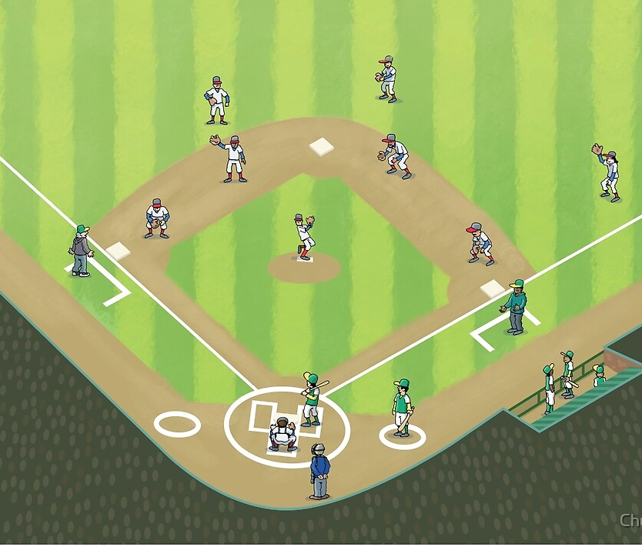

A baseball example
Four locations: pitcher’s mound, first base, home plate, and third base
Ten events:
  e₁: pitcher throws ball to home
  e₂: ball arrives at home
  e₃: batter hits ball to pitcher
  e₄: batter runs to first base
  e₅: runner runs to home
  e₆: ball arrives at pitcher
  e₇: pitcher throws ball to first base
  e₈: runner arrives at home
  e₉: ball arrives at first base
  e₁₀: batter arrives at first base
2 outs
Runner on third

Slide 24
A baseball example
Pitcher knows e₁ happens before e₆, which happens before e₇
Home plate umpire knows e₂ is before e₃, which is before e₄, which is before e₈, …
Relationship between e₈ and e₉ is unclear

Slide 25
Ways to synchronize
Send message from first base to home?
  Or to a central timekeeper
  How long does this message take to arrive?
Synchronize clocks before the game?
  Clocks drift
Synchronize continuously during the game?
  GPS, pulsars, etc

Slide 26
Real synchronization is imperfect
Clocks never exactly synchronized
Often inadequate for distributed systems
  might need totally-ordered events
  might need millionth-of-a-second precision
Approach towards solution
  Develop a logical model of event ordering (without the use of physical clocks)
    Might result into Anomalous Behavior?
  Bring in ‘Physical’ Clocks to integrate with the logical model
    Fix anomalous behavior
  Make sure that the ‘Physical’ Clocks are synced as best as we can

Slide 27
Logical time
Capture just the “happens before” relationship between events
  Discard the infinitesimal granularity of time
  Corresponds roughly to causality
Time at each process is well-defined
  Definition (→_{i}): We say e →_{i} e’ if e happens before e’ at process i

Slide 28
Global logical time
Definition: happens before (→):
We define e → e’ using the following rules:
  Local ordering: e → e’ if e →_{i} e’ for any process i
  Messages: send(m) → receive(m) for any message m
  Transitivity: e → e’’ if e → e’ and e’ → e’’
→ is only a partial-order
  Some events are unrelated
Definition (concurrency): We say e is concurrent with e’ (written e║e’) if neither e → e’ nor e’ → e

Slide 29
The baseball example revisited
e₁ → e₂
  by the message rule
e₁ → e₁₀, because
  e₁ → e₂, by the message rule
  e₂ → e₄, by local ordering at home plate
  e₄ → e₁₀, by the message rule
  Repeated transitivity of the above relations
e₈║e₉, because
  No application of the → rules yields either e₈ → e₉ or e₉ → e₈

Slide 30
Lamport logical clocks
Lamport clock L orders events consistent with logical “happens before” ordering
  If e → e’, then L(e) < L(e’)
But not the converse
  L(e) < L(e’) does not imply e → e’
Similar rules for concurrency
  L(e) = L(e’) implies e║e’ (for distinct e,e’)
  e║e’ does not imply L(e) = L(e’)
i.e., Lamport clocks arbitrarily order some concurrent events

Slide 31
Lamport’s algorithm
Each process i keeps a local clock, L_{i}
Three rules:
  At process i, increment L_{i} before each event
  To send a message m at process i, apply rule 1 and then include the current local time in the message: i.e., send(m,L_{i})
  To receive a message (m,t) at process j, set L_{j} = max(L_{j},t) and then apply rule 1 before time-stamping the receive event
The global time L(e) of an event e is just its local time
  For an event e at process i, L(e) = L_{i}(e)
Many systems require a total-ordering of events, not a partial-ordering
Use Lamport’s algorithm, but break ties using the process ID
  L(e) = M * L_{i}(e) + i
    M = maximum number of processes

Slide 32
Lamport on the baseball example
Initializing each local clock to 0, we get
  L(e₁) = 1 (pitcher throws ball to home)
  L(e₂) = 2 (ball arrives at home)
  L(e₃) = 3 (batter hits ball to pitcher)
  L(e₄) = 4 (batter runs to first base)
  L(e₅) = 1 (runner runs to home)
  L(e₆) = 4 (ball arrives at pitcher)
  L(e₇) = 5 (pitcher throws ball to first base)
  L(e₈) = 5 (runner arrives at home)
  L(e₉) = 6 (ball arrives at first base)
  L(e₁₀) = 7 (batter arrives at first base)
For our example, Lamport’s algorithm says that the run scores (kinda)

Slide 33
Lamport clock
Physical Time
p 1
0
1
2
8
7
1
p 2
3
8
0
2
2
3
6
p 3
4
0
3
5
9
10
4
7
p 4
0
5
6
7
n
Clock Value
timestamp
Message
Limitations of Lamport Clocks:
It represents a partial order, if a → b it implies that L(a) < L(b) but the converse is not true, i.e., if L(a) < L(b) it doesn’t imply a → b.

Slide 34
Lamport clock
Physical Time
p 1
0
1
2
8
Same Timestamps
p1(7) → p2(3)??
7
1
p 2
3
8
0
2
2
6
3
p 3
4
0
3
5
9
10
4
7
p 4
0
5
6
7
n
Clock Value
timestamp
Message
Limitations of Lamport Clocks:
It represents a partial order, if a → b it implies that L(a) < L(b) but the converse is not true, i.e., if L(a) < L(b) it doesn’t imply a → b.

Slide 35
Vector Clocks
With Lamport Logical Timestamp
  e → f ⇒ timestamp(e) < timestamp (f), but
  timestamp(e) < timestamp (f) ⇒ {e → f} OR {e and f concurrent}
Goal
  Want ordering that matches causality
  V(e) < V(e’) if and only if e → e’
Method
  Label each event by vector V(e) [c₁, c₂ …, c_{n}]
    c_{i} = # events in process i that causally precede e

Slide 36
Vector Clock
  A vector clock for a system of N processes is an array of N integers.
  P_{i} keeps its VC V_{i}, to timestamp local events.
  Vector clock rules:
  VC1: Initially for each process p_{i}, V_{i}[j] = 0,
  for j = 1,2, …, N
  VC2: Just before time stamping an event, p_{i} sets
  V_{i}[i] = V_{i}[i]+ 1.
  VC3: p_{i} sends t = V_{i} in every message it sends
  VC4: When p_{i} receives t in a message, it sets
  V_{i}[j] = max(V_{i}[j], t[j]), for j = 1,2, …, N
  (the max is computed component wise)

Slide 37
Vector Timestamps

Slide 38
Vector Timestamp Example
Physical Time
p 1
1,0,0,0
2,0,0,0
4,0,2,2
0,0,0,0
3,0,2,2
(1,0,0,0)
p 2
1,2,0,0
(4,0,2,2)
0,0,0,0
1,1,0,0
(2,0,0,0)
(1,2,0,0)
(2,0,2,2)
p 3
0,0,0,0
2,0,2,0
2,0,1,0
2,2,3,0
4,2,4,2
4,2,5,3
(2,0,2,0)
(2,0,2,3)
p 4
0,0,0,0
2,0,2,2
2,0,2,1
2,0,2,3
n,m,p,q
Vector logical clock
Did (1,2,0,0) happen before (3,0,2,2)?
(vector timestamp)
Message

Slide 39
Comparing Vector Timestamps
VT₁ = VT₂,
iff VT₁[i] = VT₂[i], for all i = 1, … , n
VT₁ ≤ VT₂,
iff VT₁[i] ≤ VT₂[i], for all i = 1, … , n
VT₁ < VT₂,
iff VT₁ ≤ VT₂ &
∃ j (1 ≤ j ≤ n & VT₁[j] < VT₂ [j])
VT₁ is concurrent with VT₂
iff (not VT₁ ≤ VT₂ AND not VT₂ ≤ VT₁)

Slide 40
Vector Timestamp Example
Physical Time
p 1
1,0,0,0
2,0,0,0
4,0,2,2
0,0,0,0
3,0,2,2
(1,0,0,0)
p 2
1,2,0,0
(4,0,2,2)
0,0,0,0
1,1,0,0
(2,0,0,0)
(1,2,0,0)
(2,0,2,2)
p 3
0,0,0,0
2,0,2,0
2,0,1,0
2,2,3,0
4,2,4,2
4,2,5,3
(2,0,2,0)
(2,0,2,3)
p 4
0,0,0,0
2,0,2,2
2,0,2,1
2,0,2,3
n,m,p,q
Vector logical clock
Did (1,2,0,0) happen before (3,0,2,2)?
(vector timestamp)
Message

Slide 41
Vector clocks on the baseball example
Event | Vector | Action
e₁ | [1,0,0,0] | pitcher throws ball to home
e₂ | [1,0,1,0] | ball arrives at home
e₃ | [1,0,2,0] | batter hits ball to pitcher
e₄ | [1,0,3,0] | batter runs to first base)
e₅ | [0,0,0,1] | runner runs to home
e₆ | [2,0,2,0] | ball arrives at pitcher
e₇ | [3,0,2,0] | pitcher throws ball to 1st base
e₈ | [1,0,4,1] | runner arrives at home
e₉ | [3,1,2,0] | ball arrives at first base
e₁₀ | [3,2,3,0] | batter arrives at first base
Vector: [p,f,h,t]
Did the run score?
[1,0,4,1] < [3,2,3,0] < [3,1,2,0] ??
Notes:
Runner arriving at home [1,0,4,1] is considered concurrent to ball arrives at first base [3,2,3,0] and batter arrives at first base [3,2,3,0]
Ball arrives at first basee [3,1,2,0] <= Batter arriving at first [3,2,3,0]
So… It is unknown if the runner scores

Slide 42
Important Points
Physical Clocks
  Can keep closely synchronized, but never perfect
Logical Clocks
  Encode causality relationship
  Lamport clocks provide only one-way encoding
  Vector clocks provide better causality information

Slide 43
TrueTime
Novel API behind Google Spanner’s core innovation
Leverages hardware features like GPS and Atomic Clocks
Implemented via TrueTime API.
  Key method being now() which not only returns current system time but also another value (ε) which tells the maximum uncertainty in the time returned
Set of time master server per datacenters and time slave daemon per machines.
Majority of time masters are GPS fitted and a few others are atomic clock fitted (Armageddon masters).
Daemon polls variety of masters and reaches a consensus about correct timestamp.

Slide 44
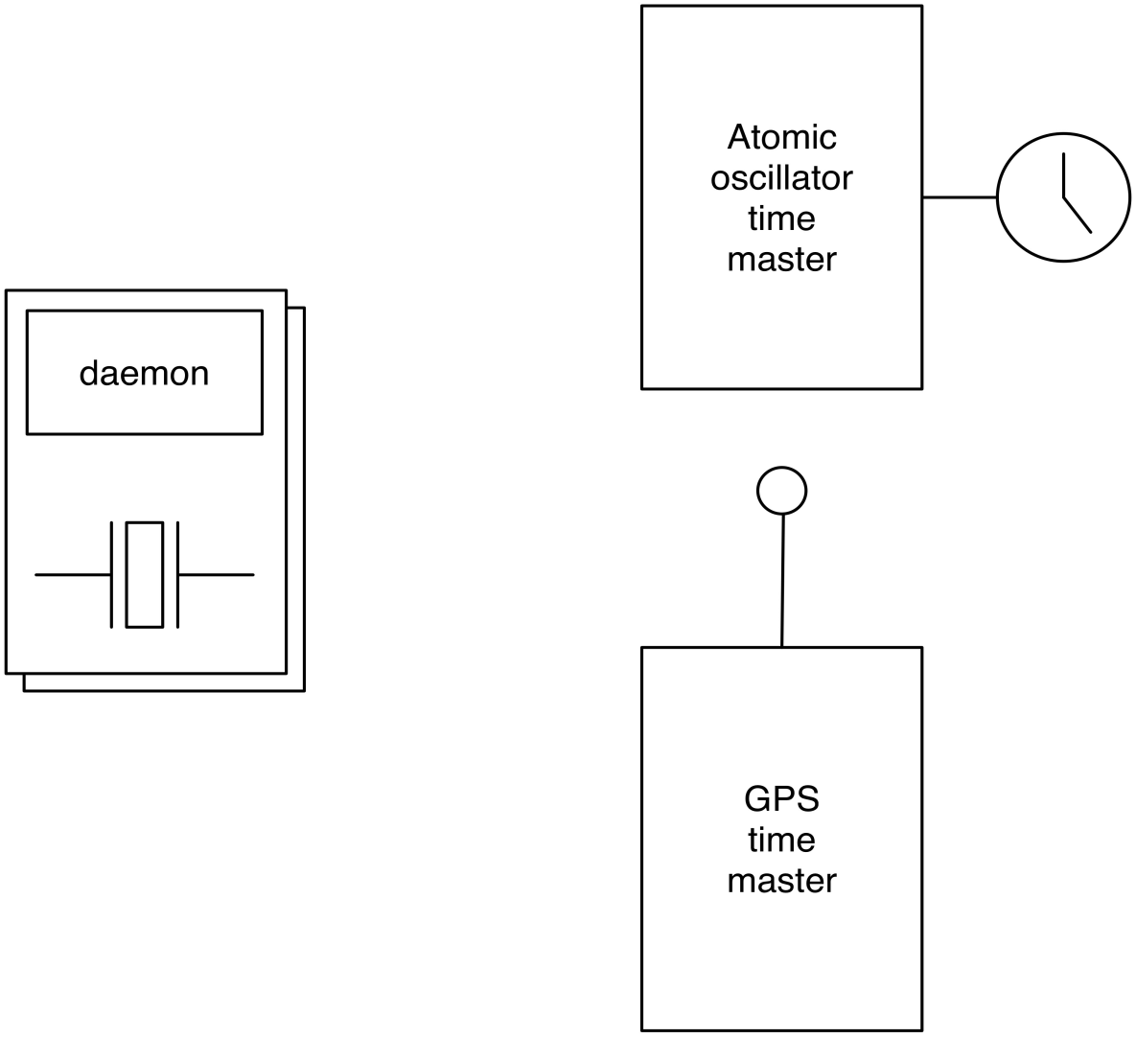
TrueTime

Slide 45
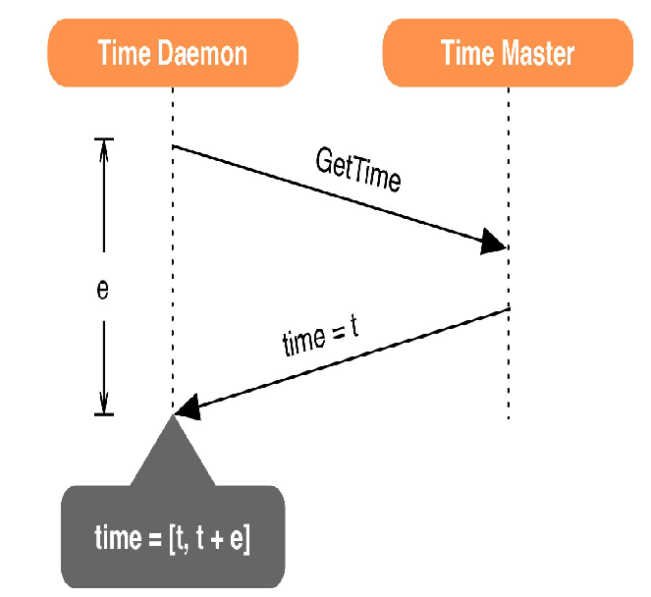
TrueTime

Slide 46
TrueTime Cont.
TrueTime uses both GPS and Atomic clocks since they are different failure rates and scenarios.
Two other boolean methods in API are
  After(ts) – returns TRUE if ts is definitely passed
  Before(ts) – returns TRUE if ts is definitely not arrived
TrueTime uses these methods in concurrency control and to serialize transactions.
TrueTime ts is an interval [t, t + ε]
  Use interval semantics for comparing timestamps

Slide 47
TrueTime Cont.
After() is used for consistency algorithm Leader Leases
  Uses after(S_{max}) to check if S_{max} is passed so that it knows data is consistent
Leaders can not assign timestamps(S_{i}) greater than S_{max} for transactions(T_{i}) and clients can not see the data commited by transaction T_{i} till after(S_{i}) is true.
  After(t) – returns TRUE if t is definitely passed
  Before(t) – returns TRUE if t is definitely not arrived
Replicas maintain a timestamp t_{safe} which is the maximum timestamp at which that replica is up to date.

Slide 48
Spanner
Spanner is currently in production used by Google’s advertising backend F1.
F1 previously used MySQL since it requires strong transactional semantics
  Impractical for most NoSQL database solutions.
Spanner provides
  Strong transactional semantics ordered by TrueTime
  synchronous replication and
  automatic failover for F1.

